Slide 1
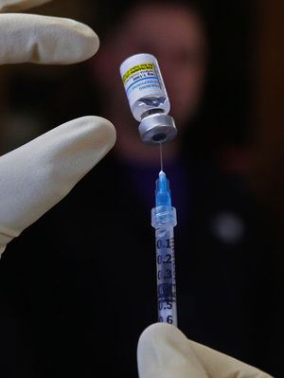
IM EPI SD
Training for EMTs to draw and inject Epinephrine 1:1,000 for anaphylaxis from a single dose vial
Created: April 1, 2022

Slide 2
When Does this Go Into Affect?
Effective July 1st, 2022, SD Codified Law will allow South Dakota Emergency Medical Technicians (EMT) to draw up and inject Epinephrine 1:1,000 IM for the patient having an anaphylactic reaction from a single dose vial.
Ambulance Services/Agencies can begin to train their EMT providers now with the approved training materials and processes from the SD Dept. of Health – Office of Rural Health – EMS Program.
EMTs must complete training and have written approval by your service’s Medical Director. EMTs can then begin using the Epinephrine draw and inject method beginning July 1st, 2022 after the paperwork has been processed by the EMS Program.

Slide 3
Objectives
Review Anaphylaxis
Demonstrate Medication Administration
Ensure Safe Injection Practices
Notes:
Review the triggers, signs, symptoms, and treatment of anaphylaxis including how to differentiate a localized allergic reaction from life threatening anaphylaxis.
Spend some time demonstrating intramuscular medication administration and how to assure they are safely drawing up, administering, and disposing of an intramuscular injection.

Slide 4
Why Allow EMTs to Draw and Inject Epinephrine?
Demonstrate the EMT provider level can safely draw and give intramuscular Epinephrine
Why not continue to use auto-injectors?
Expense -$500-1000/vehicle
Potential injury to providers
Rarely used
Potential to save the EMS system millions while maintaining ability to treat patients
Notes:
EMTs have successfully shown through other demonstration programs such as naloxone and CPAP administration, that they are capable of providing what were previously considered advanced skills. The injection of intramuscular Epinephrine is another such skill, that with the proper training, EMTs can safely administer.
Although auto-injectors are one way to administer life-saving Epinephrine to a patient with anaphylaxis, it is not the only way. The cost, and potential for self-injury are not insignificant and moving to a different delivery mechanism has the potential to save our EMS systems millions of dollars while maintaining the important ability to treat patients with anaphylaxis.

Slide 5
History of Syringe Epinephrine Kits
King County, Washington
Hundreds of BLS implementations
No injuries to providers
No failures to treat patients (had some appropriate increases to treatment)
Some States which allow EMTs and above to draw and inject Epinephrine for anaphylaxis:
Washington, New York, Montana, Alaska, Florida, Illinois, Ohio, South Carolina, Wisconsin, Oregon, Colorado, Idaho, Kentucky, West Virginia
Notes:
King County Washington began their program in 2014, and have demonstrated through hundreds of applications, that BLS providers were able to successfully administer Epinephrine to a patient experiencing anaphylaxis. In some instances, treatment may have been aided by the use of the syringe Epinephrine kit versus conventional Epinephrine auto injectors. All these administrations were done safely, and without injury to providers.
Since that time, several other regions, in states across the country, have also successfully implemented similar programs.

Slide 6
Anaphylaxis Overview
Serious Life-Threatening Systemic Allergic Reaction
Systemic (multi-system) Involvement
Shock (poor perfusion)
Respiratory Distress Symptoms
Rapid Onset
Anaphylaxis WILL lead to DEATH if left untreated
Notes:
Let’s start with a review of anaphylaxis. Anaphylaxis is a systemic reaction, meaning that it affects the entire body. It is typically characterized by shock and/or respiratory symptoms that are characterized by a rapid onset. It is not necessary for all of the individual components to be present for a patient to be in anaphylaxis. Important to remember is that a patient experiencing anaphylaxis, who is left untreated, will die.

Slide 7
Anaphylaxis is NOT….
An insect bite that itches
A runny nose
Sneezing
Watery eyes
Notes:
Also important is that Anaphylaxis is not the same as an allergic reaction or seasonal allergies that many of us may have experienced. These may include an insect bite that itches, a runny nose, sneezing, or watery eyes. Although these are allergies, they do not have the rapid onset of systemic effects that are found with anaphylaxis.

Slide 8
Anaphylaxis IS….
A Systemic and Life-Threatening Allergic Reaction from Contact/Exposure with an Allergen
Rapid Onset
Multi-System
Life Threatening
Notes:
So again, anaphylaxis is sudden, systemic, and life threatening. Although anaphylaxis is not the same as an allergic reaction, they are similar in that both result from an exposure to an allergen – an important point to consider when you are making your treatment decision.

Slide 9
Anaphylaxis vs Allergic Reaction
Allergic Reaction – A localized allergic reaction. May be treated with antihistamines.
Anaphylaxis – Is a multi-system issue which may cause the collapse of circulatory and/or respiratory systems. EMS should consider Epinephrine as the first-line of defense.
Notes:
Allergic reactions and anaphylaxis are serious and potentially life-threatening medical emergencies. It is the body’s adverse reaction to a foreign protein, pollen, insect sting or any ingested, inhaled, or injected substance. A localized allergic reaction (which does not compromise the airway) may be treated with antihistamine but not by an EMT. When anaphylaxis is suspected, EMS personnel should always consider Epinephrine as first-line treatment. Cardiovascular collapse may occur abruptly without the prior development of skin or respiratory symptoms. Constant monitoring of the patient’s airway and breathing is essential.
Contrary to common belief that all cases of anaphylaxis present with cutaneous manifestations, such as urticaria or mucocutaneous swelling, a significant portion of anaphylactic episodes may not involve these signs and symptoms on initial presentation. Moreover, most fatal reactions to food-induced anaphylaxis in children were not associated with cutaneous manifestations.

Slide 10
Common Causes of Anaphylaxis
Food – Such as Nuts, Shellfish & Fruits
Insects – Bees & Wasps
Medications - Antibiotics
Notes:
An anaphylactic reaction is triggered by an allergen. An allergen can be just about any substance that a patient may come in contact with. We know that some substances are more likely to cause an anaphylactic reaction and may also cause the reaction to be more severe or progress quicker.
Some of these allergens, and therefore causes of anaphylaxis, include certain foods, such as nuts, or shellfish; sensitivity to bees, wasps, and other insects, medications such as antibiotics, or even plants or latex.

Slide 11
Anaphylaxis - Treatments
Epinephrine
Immediate treatment – Lifesaving
Improves respiratory distress
Reduces airway swelling
Treats shock
Supplemental ALS Interventions
Antihistamines (Diphenhydramine)
Nebulizers (Albuterol)
Steroids (Prednisone or Methylprednisolone)
Notes:
The lifesaving treatment of anaphylaxis is very simple – patients need an intramuscular injection of Epinephrine to improve respiratory distress, reduce any airway swelling, and counteract hypotension.
Additional interventions such as anti-histamines, nebulizers, and steroids may be given by advanced life support personnel, but nothing is more important than Epinephrine.

Slide 12
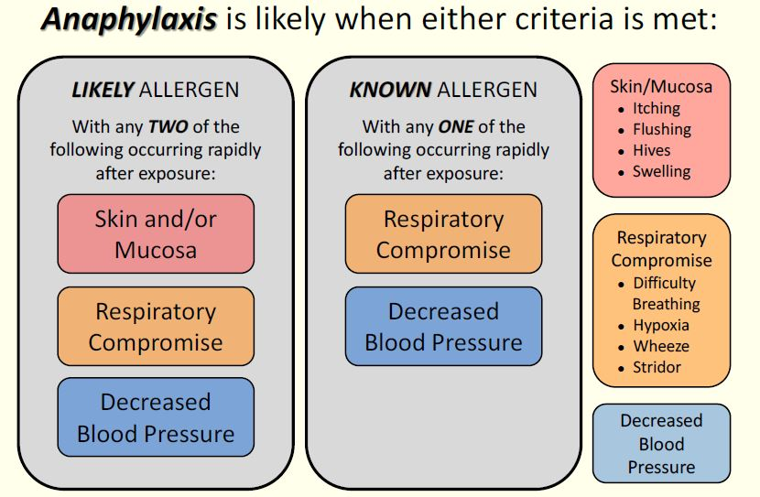
Patient in Anaphylaxis
Notes:
If our patient is exposed to a likely or common allergen but has not had a prior anaphylactic reaction, when that occurs, and the patient rapidly experiences signs or symptoms from any two categories listed above, the provider should administer an injection of intramuscular Epinephrine. So let’s say we have a child that is eating peanut butter for the first time, and rapidly develops hives and difficulty breathing – this person would meet the definition of anaphylaxis as they have a potential exposure to an allergen, and both skin and respiratory symptoms. Alternatively, let’s say a gentleman is stung by a bee, rapidly develops difficulty breathing and then passes out. You note him to have a very low blood pressure – this person would also meet the definition of anaphylaxis as he has been exposed to a likely or potential allergen and has both respiratory symptoms and a decreased blood pressure. Both of these patients have anaphylaxis and would be best treated with an intramuscular injection of Epinephrine.
If our patient has had a previous anaphylactic reaction and may even have an Epinephrine auto injector prescribed to them as a result, following the exposure, the provider should administer an injection of intramuscular Epinephrine when signs or symptoms from any one category is present. So for example, a woman with a known shellfish allergy is exposed to crabmeat and has immediate shortness of breath – this person would also meet the definition of anaphylaxis as she is exposed to a known allergen and has respiratory symptoms.
These combinations of exposures, signs, and symptoms can help identify patients in anaphylaxis. However, anaphylaxis is not limited to just these specific algorithms. Each provider needs to assess each patient on a case by case basis to determine the presence of anaphylaxis and the need for an intramuscular injection of Epinephrine. This chart is a convenient reference for many of the most common presentations, but all care decisions must ultimately be made within the scope of local or state patient care guidelines, or with direction from a medical control physician.

Slide 13
Follow Your Patient Care Guidelines and Medical Control / Medical Director
Notes:
Follow your local or state medical guidelines.
Taking a closer look at the EMT section of the guidelines, you will notice that the provider is directed to administer Epinephrine in the setting of anaphylaxis after addressing airway management and oxygen therapy.

Slide 14
Bee-Careful at Summer Camp
15 year-old girl at summer camp when stung/bitten by an unknown insect on her cheek
30 minutes later she walked to the camp infirmary
She has an Epinephrine auto-injector for bee stings
Pain locally, unable to open her right eye
Vital signs on EMS Arrival:
RR: 24
HR: 96
BP: 132/64
Lungs: Increased respiratory rate, clear
Notes:
So now that we have reviewed the indications and importance of Epinephrine in the anaphylactic patient, let’s review a few cases.
Our first case involves a 15 year old girl that was stung by ‘something’ while she was at summer camp. Several minutes later, her eye began to swell and she walked to the nurse’s office. Her exam is as depicted on the slide.
An ambulance was called for the patient to be evaluated. The patient walked to the ambulance where EMTs transported her to a local community hospital after speaking with parents via phone.
En-route, the crew monitored her for any airway swelling, difficulty breathing, or changes in mental status. She was delivered to the hospital ED without progression of her symptoms.
In this case, our patient appropriately did not receive Epinephrine. Although she was exposed to a potential allergen, she exhibited only skin findings and did not have respiratory symptoms or hypotension. Importantly, however, the EMT monitored the patient closely for any change in her condition, as sudden hypotension or respiratory symptoms would be an indication for Epinephrine.

Slide 15
Not So Special Night Out
79 year-old woman allergic to shellfish
Taken out to dinner – No known exposure
She developed hives over her face, chest and back
Took Benadryl
Called EMS after experiencing difficulty breathing
Vital signs on EMS Arrival:
RR: 26
HR: 106
BP: 102/52
Lungs: Wheezes, shallow, retractions at the neck and intercostal Spaces
Notes:
This case involves an elderly woman who was out to dinner with family for a birthday celebration. Shortly after arriving home, she noticed this rash across her back, chest and face while getting ready for bed. As she has a known allergy to shellfish, she is typically very careful about what she eats, but believes she may have been exposed during dinner unknowingly. When she began to have difficulty breathing, she called 911.
When EMT’s arrived, this patient was recognized to be suffering from an anaphylactic reaction after only a brief assessment and history of events. The patient has a rash and respiratory symptoms, in the setting of a likely allergen exposure. The EMTs immediately administered Epinephrine in her left thigh as there are no contraindications to Epinephrine in the setting of anaphylaxis. The patient was placed on oxygen, moved to the ambulance, and transport to the ED was begun.
En-route, the patient reported resolution of her difficulty breathing and reassessment revealed easy ventilations and clear lung sounds. Advanced Life Support was met en-route, and the patient was closely monitored for reoccurrence of symptoms for the remainder of the transport.
In this case, our EMT’s appropriately administered Epinephrine to our patient with a known allergy history and respiratory symptoms.

Slide 16
Barely Surviving Strawberries
3 year-old girl felt sick to her stomach after eating strawberries at family picnic
Rash around patient’s mouth
Patient became pale and lethargic over the next 15 minutes
Vital signs on EMS Arrival:
RR: 12
HR: 64
BP: Cap. Refill >4 seconds
Lungs: Nearly absent, faint wheezes noted.
Patient is unresponsive
Notes:
Our final case involves a young three year old child that was at a family picnic with friends and relatives. The patient approaches her mother, carrying a large bowl of strawberries, her face appears covered in strawberries, and she is complaining that she doesn’t feel well. The child crawls up into her mother’s lap, resting her head against her, and appears to fall asleep.
10-15 minutes pass when a relative points out that the patient looks pale, and asks about the rash around her mouth. As the mother tries to wake the patient, she finds that she is unable to do so and EMS is requested.
EMT’s arrive and recognize that despite the lack of more classic symptoms, this patient was experiencing an anaphylactic reaction. She has an exposure to a potential allergen, has signs of shock including delayed capillary refill and altered mental status, as well as poor respirations.
The EMT’s assist her ventilations, administer Epinephrine, and begin transport as they should not delay on scene waiting for Advanced Life Support. Fortunately, the crew was able to intercept with ALS en route to the hospital. The patient became increasingly more alert and began crying forcefully at the time of their intercept, allowing the EMTs to discontinue the assisted ventilations.
This is certainly not a classic presentation of anaphylaxis, but our patient had a possible exposure and important to remember is that not all anaphylactic reactions have hives and swelling. These more subtle symptoms should not delay the administration of Epinephrine, as it is lifesaving in this little girls case.

Slide 17
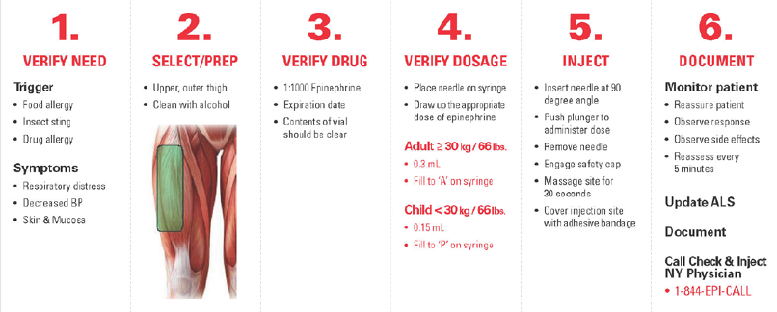
Check & Inject NY
Example of their Epinephrine Injection Process Card
Adult 25kg or more = 0.3 mg (0.3ml)
Pediatric less than 25kg = 0.15mg (0.15ml)
Created by University of Rochester School of Medicine
Notes:
Now that we have reviewed the signs and symptoms of anaphylaxis and we know who we should be giving Epinephrine to, let’s review how to give them that lifesaving Epinephrine. Anytime a medication is given to a patient, it is important that several factors are verified before the actual medication administration occurs. Every time we must ensure that we have identified a need for the drug’s administration, selected a proper route of administration, and verified both our drug and dosage before any administration occurs. We must then properly administer and document that administration as our care continues and is eventually transferred to another provider.
Let’s take a minute to review each section as it pertains to the administration of intramuscular Epinephrine for anaphylaxis.

Slide 18
1 – Verify Need
Notes:
The first step is to verify the need for Epinephrine.
As we discussed earlier, only a patient in anaphylaxis is going to receive an intramuscular injection of Epinephrine. That determination comes from an exposure to an allergen, associated signs and symptoms of anaphylaxis, and guidance from your local or state guidelines. We discussed some common signs and symptoms earlier.

Slide 19
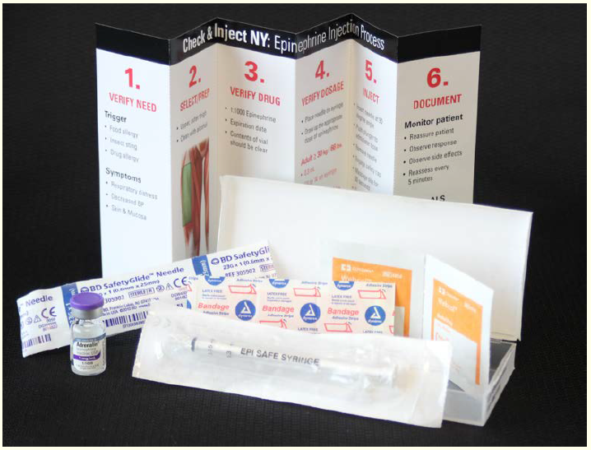
Syringe EPI Kit
NY Check & Inject Epinephrine Kit
Notes:
Here we can see a Check and Inject Kit that can be used.
You can see that the syringe Epinephrine kit is sealed, the label is intact, and the expiration date has not passed.
Opening the kit, we can inspect the individual components which are also listed on the cover.
The kit includes:
• One vial of Epinephrine
• One custom syringe
• One safety needle
• Two alcohol wipes
• One adhesive bandage

Slide 20
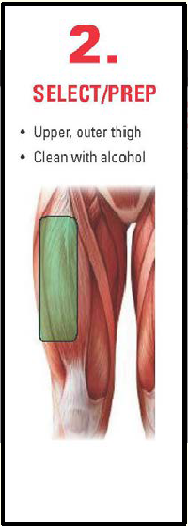
2 – Select and Prep Site
Notes:
Our second step is to select and prepare the site for injection. Put on PPE gloves and call for ALS intercept.
The only site approved is the upper lateral thigh. The site should be exposed so the injection can be given directly into the skin. This site will be cleaned with alcohol wipes.

Slide 21
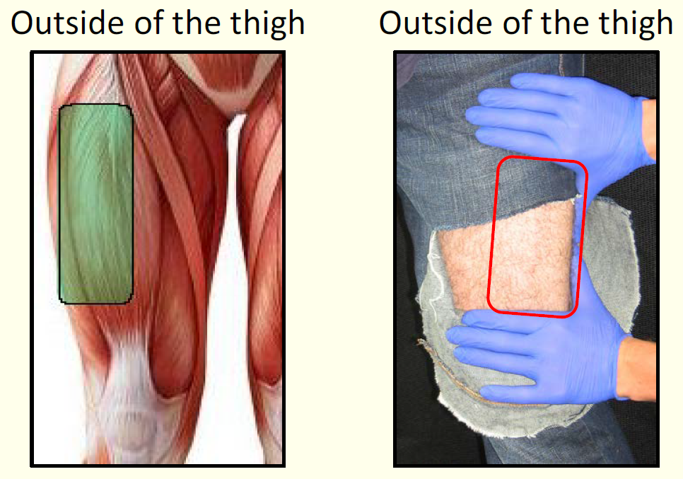
Upper Leg
Notes:
Ideally, any intramuscular injection should be administered in the bare skin that can be visualized by the provider. Once you have identified the proper site, as we have illustrated, the site should be cleansed with the alcohol pads. The site will have plenty of time to dry as you complete the next steps in the process. There is no need to blow on or fan the site once it has been cleansed.
If needed in only the most acute of settings, the Epinephrine may be administered with syringe through a layer of clothing; however our preference is the medication is administered to bare skin.

Slide 22
3 – Verify Drug
Notes:
Our third step is to verify the drug.
When a drug is administered through the intramuscular route, the provider needs to ensure that they are administering the correct drug, the drug has not passed its expiration date, and that the contents of the vial are clear, and free of floating objects.

Slide 23
Epinephrine
Notes:
Whenever you administer a drug, you should have an understanding of how that drug is intended to work, what side effects can be expected, and what complications may arise and how those should be managed.
You may recall, Epinephrine is a manufactured form of adrenaline, which is naturally occurring in the body. Epinephrine works to stimulate the sympathetic nervous symptom of our body. In other words, it turns on our fight or flight response.

Slide 24
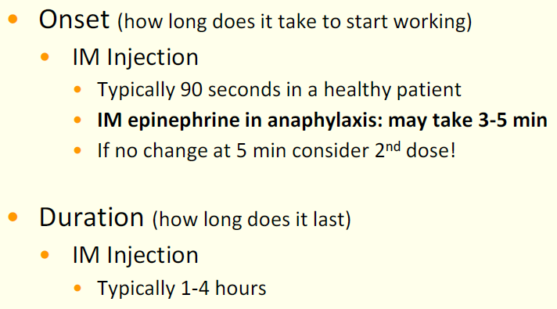
Epinephrine
Notes:
The onset of a drug is how long it takes for our body to respond. This time can vary greatly depending on the drug itself and the route by which it was administered to a patient. Some drugs may work in seconds, while others could take a half hour or more.
Epinephrine, administered through the intramuscular route, would typically begin working in as few as 90 seconds if it were administered to a healthy patient. Since we are administering Epinephrine to a patient in distress, it may take as long as 3-5 minutes before the Epinephrine begins to work. It is also possible that a single dose is not sufficient to treat a patient. By understanding the onset of the drug, we can also understand why we should be considering our second dose of Epinephrine in as little as 5 minutes after the initial dose was administered.
Once the provider begins to see improvement in the patient, the duration, or how long the drug will last, can be one to four hours. It can also be much shorter than that, and frequent reassessment is essential.

Slide 25
Epinephrine
Notes:
It is important to recognize that there are no contraindications to the administration of intramuscular Epinephrine in a patient experiencing anaphylaxis.
When you practice this skill later on, you should have a copy of your state or local guidelines to reference. It is possible that guidelines may restrict your ability to administer Epinephrine in some situations. If that is the case, you MUST follow your guidelines and/or direction from your agencie’s Medical Director, despite the information that was presented here today. You must have your Medical Director’s approval in writing.
Side effects of Epinephrine are related to its effect on our fight or flight response. We can expect someone to have received Epinephrine to potentially experience palpitations, high blood pressure, feeling anxious or jittery, having tremors, or experiencing a headache. All are known side effects of the medication, but these side effects are outweighed by the lifesaving effects of the drug.

Slide 26
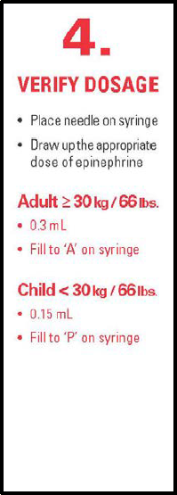
4 – Verify Dosage
Adult 25kg or more = 0.3 mg (0.3ml)
Pediatric less than 25kg = 0.15mg (0.15ml)
Notes:
Our fourth step is to verify the dosage and draw up the appropriate dose.

Slide 27
Right Dose – Adult & Pediatrics
Adults (25 kg or more) = 0.3 mg (0.3 ml)
Pediatrics (less than 25 kg) = 0.15 mg (0.15 ml)
To convert the patient’s weight from pounds to kilograms, divide by 2.2
(weight in pounds / 2.2 = weight in kilograms)
Notes:
The standard dose of Epinephrine across South Dakota is 0.3 mL for adults, and 0.15 mL for pediatrics. The difference between adult and pediatric patients is made based on the weight of the patient, and not chronological age. Patients weighing 25 kg or more will receive an adult dose of intramuscular Epinephrine. Patients weighing less than 25 kg will receive a pediatric dose.
The syringe Epinephrine project is intended only to evaluate the replacement of Epinephrine auto injectors. The 0.3 mL and 0.15 mL doses correlate to that found in the adult and pediatric Epinephrine auto injectors that are commercially available.

Slide 28
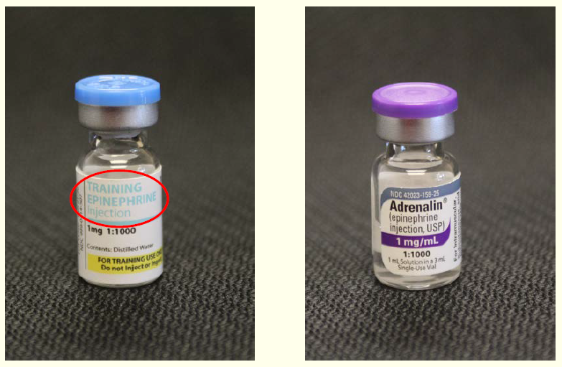
Drawing Up Epinephrine (1:1,000)
From a single dose vial
Notes:
During the training process, we will be utilizing a training vial of Epinephrine which should be clearly labeled. The vial differs slightly in appearance, and the contents are water, but the vial is otherwise identical to the actual Epinephrine found in the syringe Epinephrine kits. Providers should verify that they are administering the correct drug, the drug has not passed its expiration date, and that the contents are clear and free of debris.

Slide 29
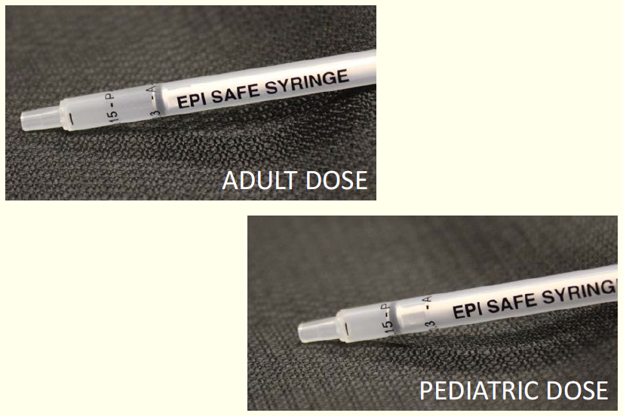
Drawing Up Epinephrine
Notes:
Here you can see the Check & Inject’s custom designed syringe. The top image highlights the marking for an adult dose while the image on the bottom highlights the marking for a pediatric dose. 1cc syringe may also be used.

Slide 30
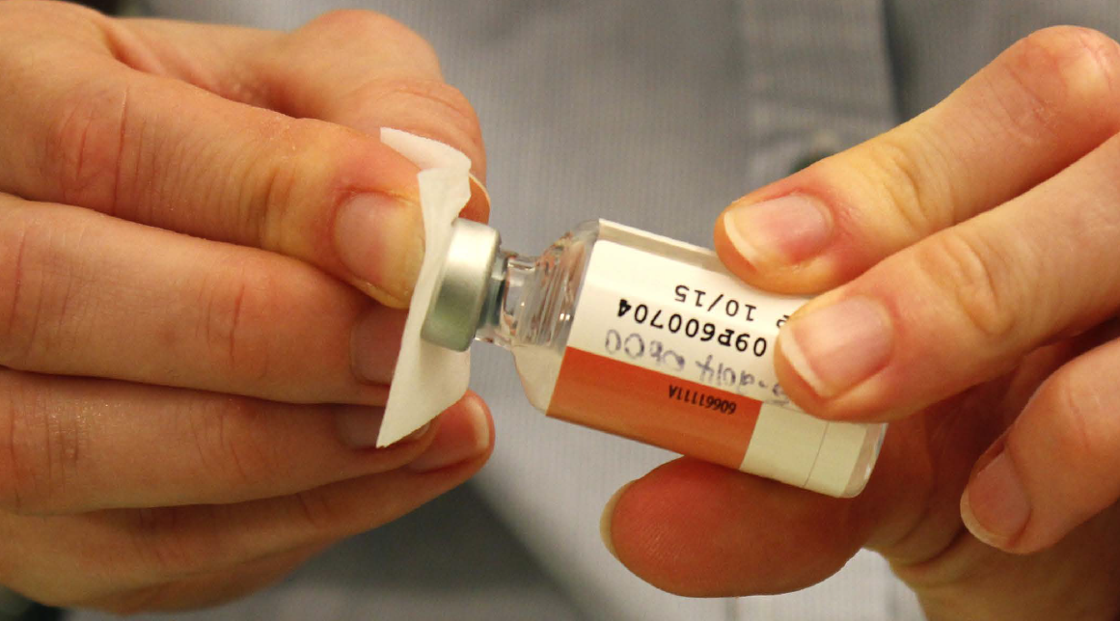
Clean Top of the Vial
Clean vial top with alcohol pad before injecting needle.
Notes:
Important steps
1. Always use aseptic technique when preparing and administering injections to a patient
2. Always wipe the outer surface of the rubber stopper of injection vials with a 70% isopropyl alcohol swab
3. Allow rubber stopper to dry before inserting any device into the vial

Slide 31
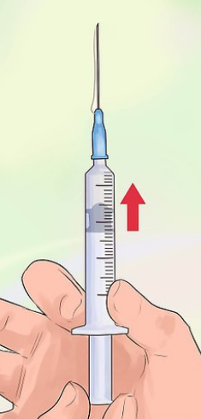
Expel any Additional Air or Fluid
Discard needles that touch hands, surfaces or non-sterile objects
Surfaces and hands contain microbes (germs)
Sterile devices become non-sterile if touched.
Notes:
Tap the syringe with your finger to move air bubbles to the top. Then push gently on the plunger to push the air bubbles back into the vial. If you have a lot of bubbles, push the plunger to push all the medicine back into the vial. Draw medicine out again slowly and tap air bubbles out.

Slide 32
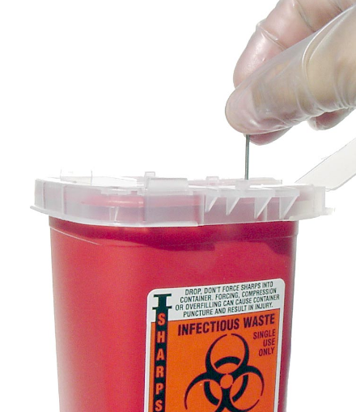
Procedure if Needle Becomes Contaminated
Discard any needle that touch hands, surfaces or non-sterile objects.
Replace gloves.
Replace needle with new sterile needle before injecting patient.
Notes:
Do not allow any equipment or solution that will enter the body to become contaminated. This includes avoiding contact between those items and nonsterile surfaces or items. Needles, IV catheters, and IV tubing connections all must be kept sterile. Good hand washing and cleaning and disinfection of equipment and surfaces are also important measures in infection control.

Slide 33
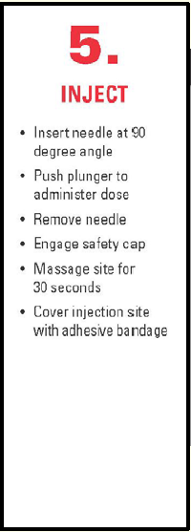
5 - Inject
Notes:
Once the drug is drawn into the syringe, our fifth step is to inject the medication.
The injection process is a skill that you will have an opportunity to practice. It is important to administer the injection correctly to ensure your patient receives the necessary medication, but also to understand safe handling practices of the needle to ensure the safety of you and your colleagues.

Slide 34
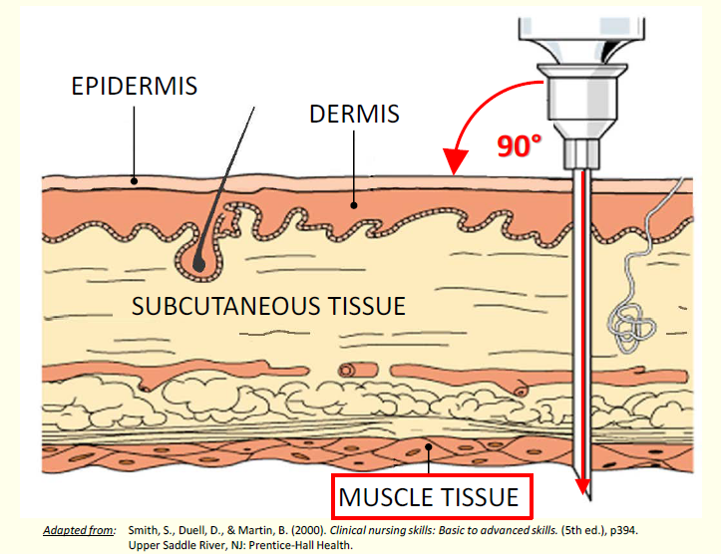
Intramuscular (IM) Injection
Notes:
To inject, you want to align the syringe and needle above the injection site at a 90 degree angle to the skin. It is important that the needle reaches through the subcutaneous tissues, as it may take twice as long for Epinephrine to have its life-saving effect if not injected directly into the muscle.
The plunger can then be pushed completely to administer the entire dose.
Once the injection is complete and the needle removed, the safety mechanism is engaged. The entire syringe should be properly disposed of in a sharps container. It is never acceptable to leave the needle unattended or in any location outside of an approved sharps container after administration.

Slide 35
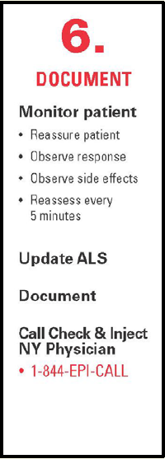
6 - Document
Notes:
Once the Epinephrine has been administered, and the needle has been safely disposed of, reassessment of the patient should begin. Ideally, we want and expect our patient’s signs and symptoms to improve. You should be observing for signs of improvement or side effects, begin transport, and recall that if the patient has not had any significant improvement after five or more minutes, that your guidelines may allow a second dose of Epinephrine. Whenever possible, please update your responding advanced life support agency, and if you are a transporting unit, do not remain on scene waiting for ALS. After your transfer of care, you will document.

Slide 36
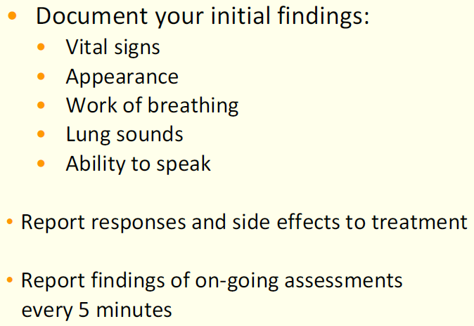
6 - Document
Notes:
There are several reasons we need good, accurate documentation. Remember that good documentation includes a thorough assessment both prior to, and following medication administration. That documentation should include the patient’s condition and their response; as well as any side effects to treatment. Generally, you should be assessing and documenting that assessment every five minutes, if not even more frequently for the patient in anaphylaxis.

Slide 37
Group Content Knowledge Test
1.) What is anaphylaxis?
The same thing as an allergic reaction
An acute, life-threatening allergic reaction, that occurs within seconds, to an antigen which the body has become hypersensitive
A condition in which the immune system reacts abnormally to a foreign substance
Hypersensitivity of the immune system to something in the environment that normally causes little problem

Slide 38
Group Content Knowledge Test
2.) Administration of is the lifesaving treatment of anaphylaxis:
Benadryl
Epinephrine
Steroids
Albuterol

Slide 39
Group Content Knowledge Test
3.) Which patient would receive an adult dose of Epinephrine in the case of anaphylaxis?
A patient that weighs 24 kg
A patient that weighs 11 kg
A patient that weighs 23 kg
A patient that weighs 35 kg

Slide 40
Group Content Knowledge Test
4.) Where is the best place to administer Epinephrine in the presence of anaphylaxis?
Arm
Thigh
Buttocks
Veins

Slide 41
Group Content Knowledge Test
5.) How long after administering Epinephrine should you expect for the signs and symptoms of anaphylaxis to improve?
Immediately
60 seconds
3-5 minutes
D. 10 minutes

Slide 42
Group Content Knowledge Test
6.) What dose of Epinephrine would you give to a 12-year-old patient who weighs 81lbs or 35kg and is exhibiting symptoms of anaphylaxis?
0.15 mg IM
1.5 mg IM
0.3 mg IM
3.0 mg IM

Slide 43
Group Content Knowledge Test
7.) Which of the following are NOT expected side effects of Epinephrine?
Anxiety and palpitations
Trembling or shaking of the hands or feet
Headache and hypertension
Increased wheezing

Slide 44
Group Content Knowledge Test
8.) Which of the following is a sign/symptom of an allergic reaction but does not indicate anaphylaxis?
Trouble breathing
Red, swollen, and itchy skin at the site of a bee sting
Hypotension
Confusion

Slide 45
Group Content Knowledge Test
09.) A 10-year-old patient who weighs 88lbs or 40kg is stung by a bee. Which of the following would be an indication that Epinephrine should be given?
Swollen lips
Hives on her stomach
Localized angioedema that does not compromise the airway
Severe pain at the site of the sting

Slide 46
Group Content Knowledge Test
10.) Which of the following MUST be reassessed every five minutes after Epinephrine is administered:
Pain
Anxiety level
Capillary refill
Work of breathing

Slide 47
Next Steps
Practice Hands-On training of the draw and injection of Epinephrine
Take and pass the Psychomotor (hands on) Exam
At the end of the training, your instructor will sign you off with the completion date of this training and change your status to “Pass” in their E-Licensing account – Instructor area (Manage Courses). This will then generate a training certificate, which will be in your “Documents” section in your E-Licensing account, and also go into your Education “My Report” for continuing education credit for your current recertification cycle.
IMPORTANT: Your Agency’s Medical Director has final say (in writing) to allow you or your service to administer 1:1,000 draw-and-inject Epinephrine IM from a single dose vial for a patient in anaphylaxis for the EMT provider level.

